Slide 1

The Aga Khan Hospital Dar es Salaam
Prof. Yasin Mgonda - OPA Documentation Compliance for Q4 2022

Slide 2
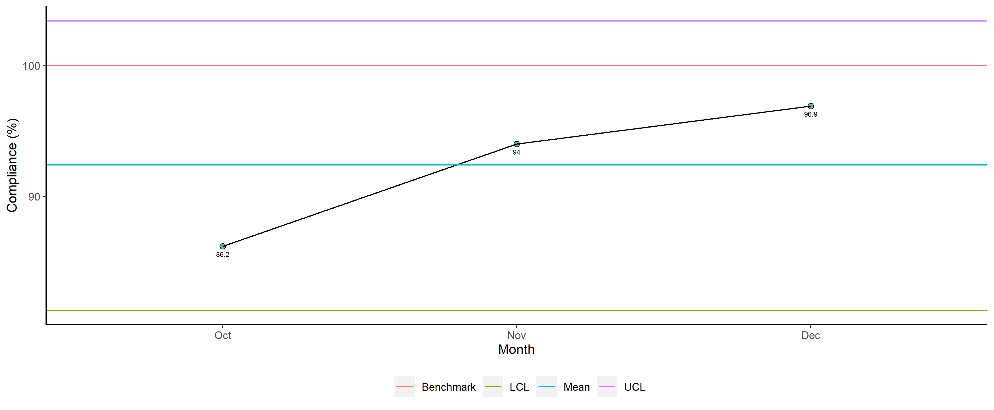
Prof. Yasin Mgonda - Availability of Required Documents

Slide 3
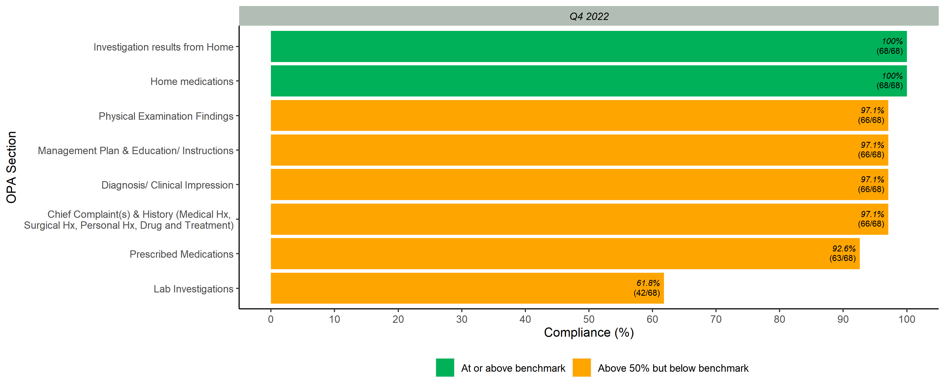
Documented Scores per OPA Section

Slide 4
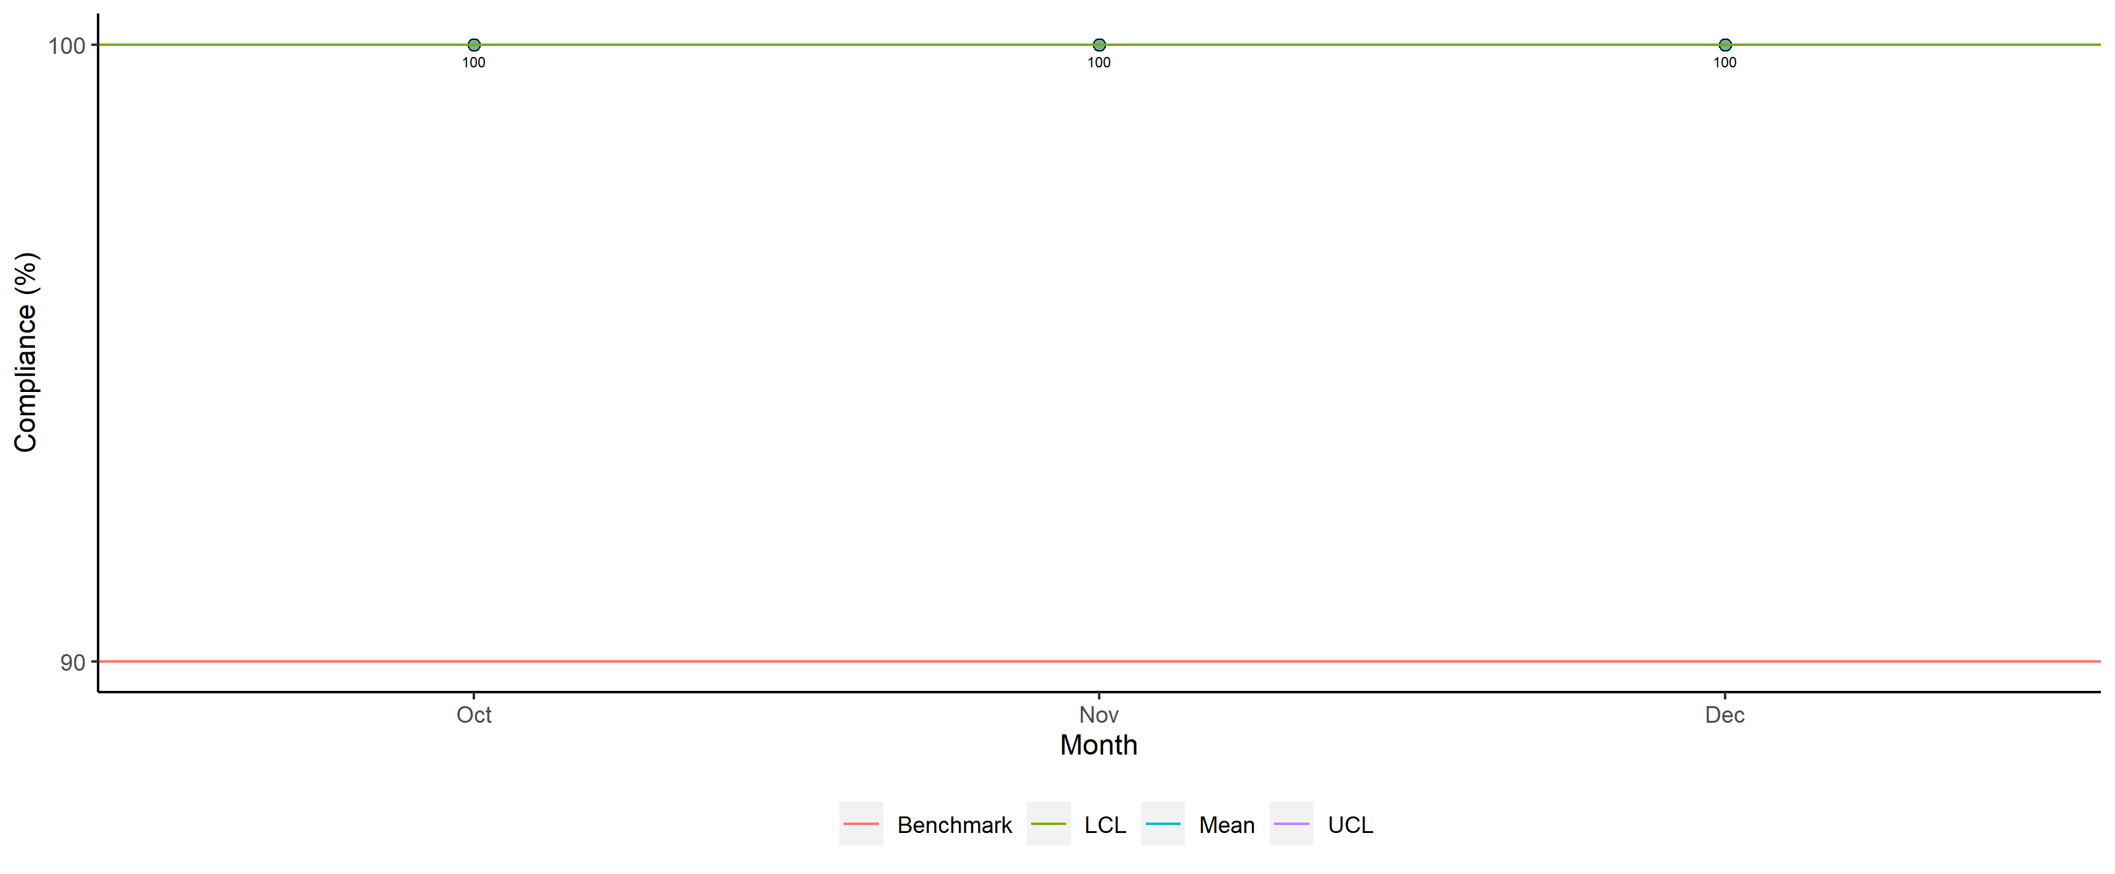
Prof. Yasin Mgonda - Legibility

Slide 5
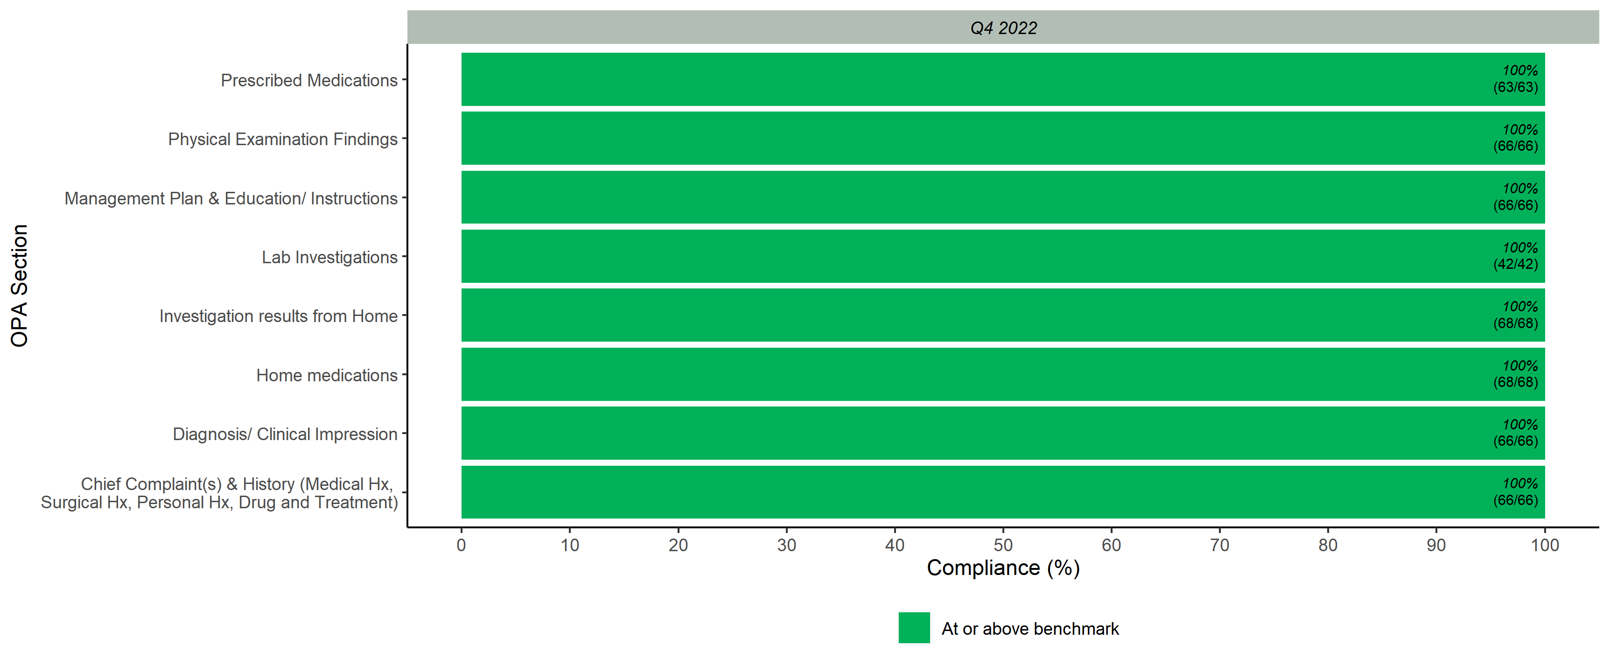
Legibility Scores per OPA Section

Slide 6
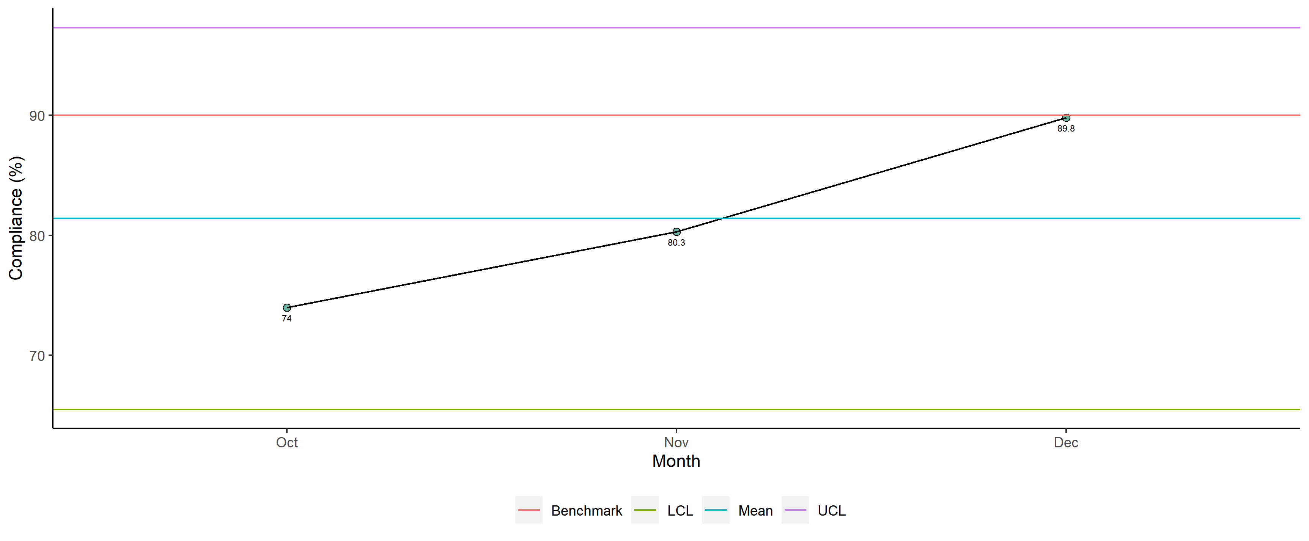
Prof. Yasin Mgonda - Completeness

Slide 7
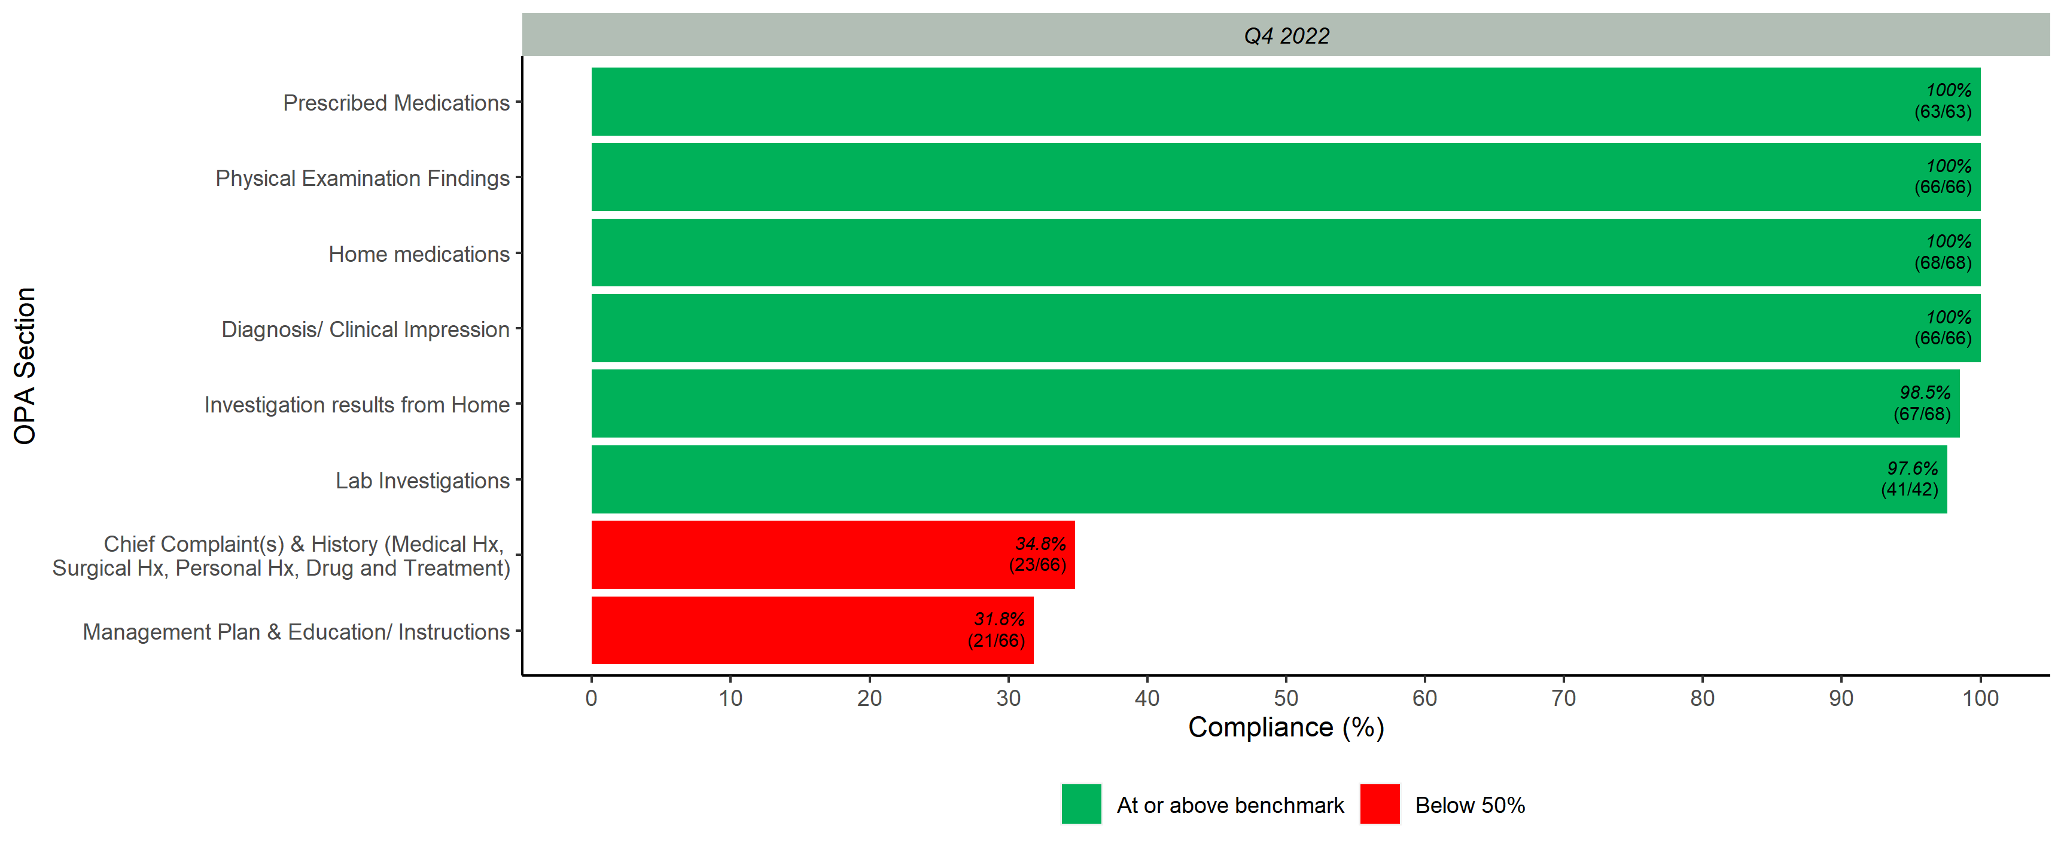
Completeness Scores per OPA Section

Slide 8
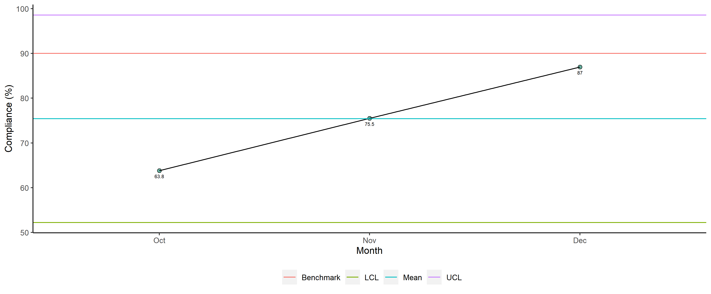
Prof. Yasin Mgonda - Overall

Slide 9
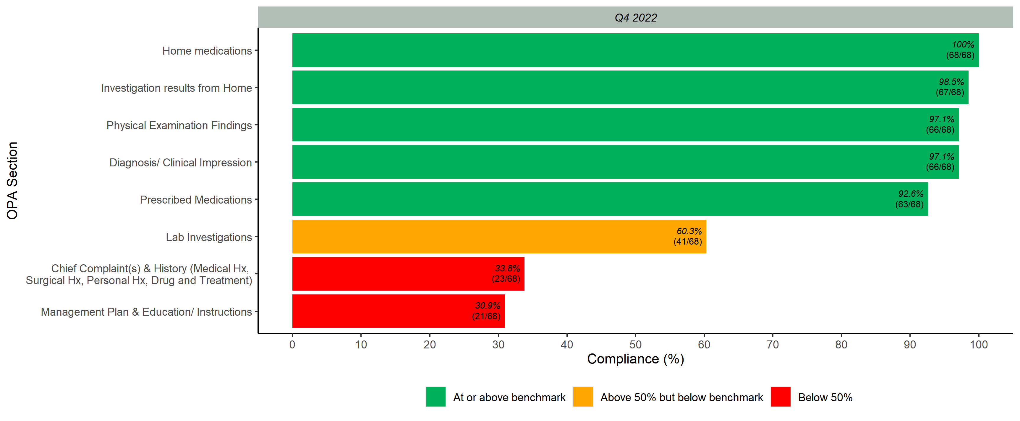
Overall Scores per OPA Section

